Slide 1

ECOSCAN
Plant Disease Detection System

Slide 2
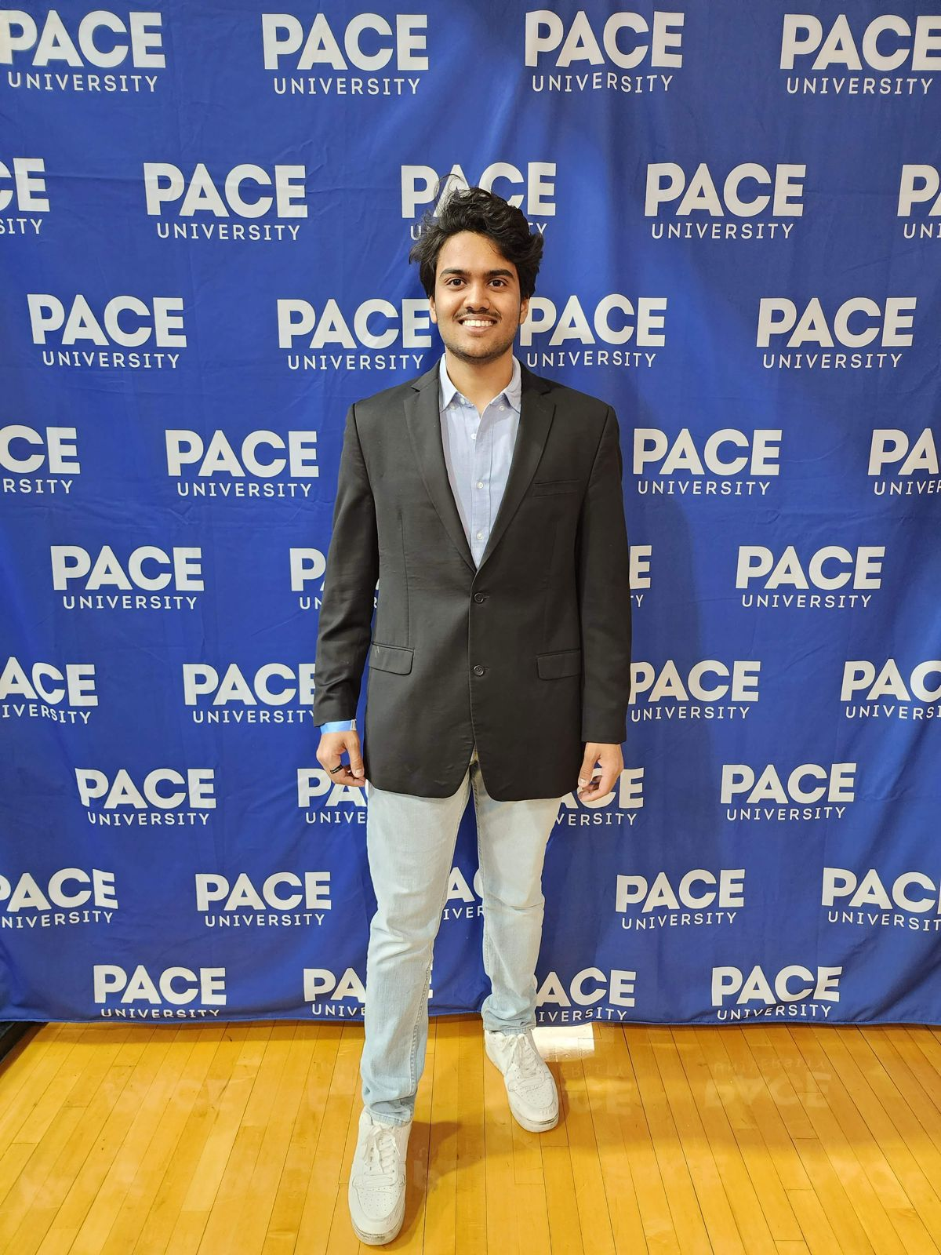
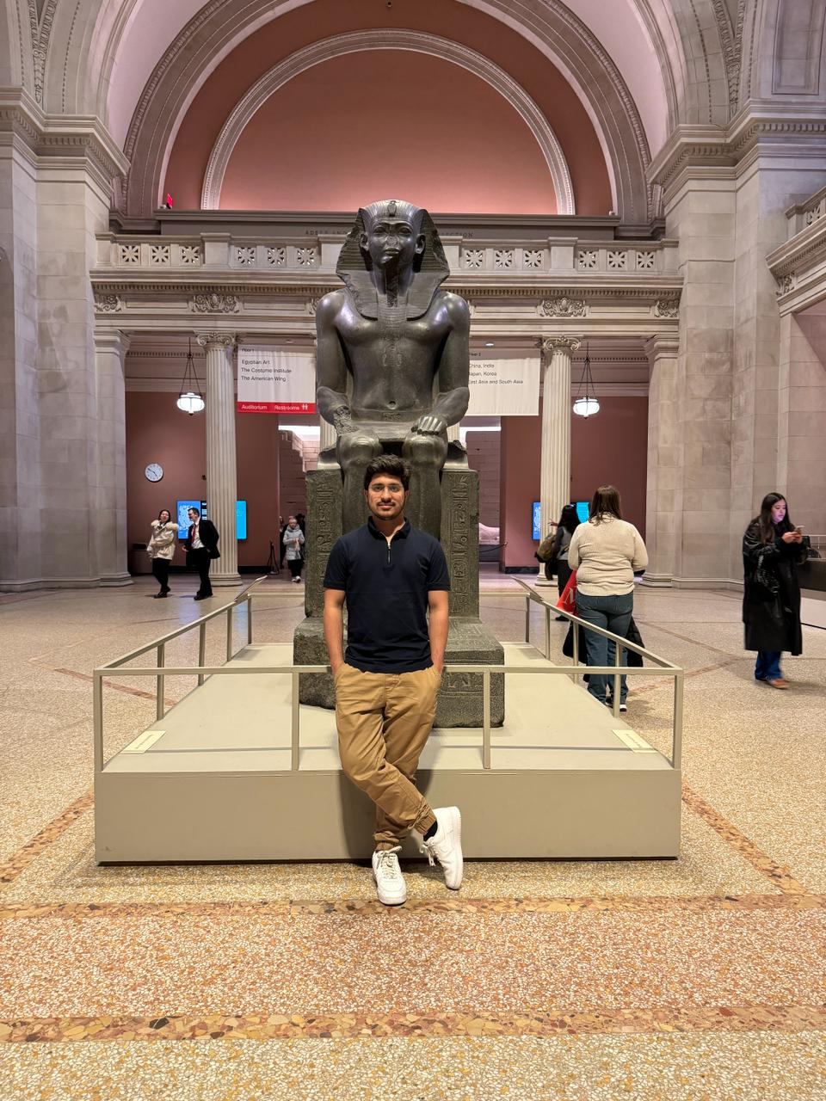
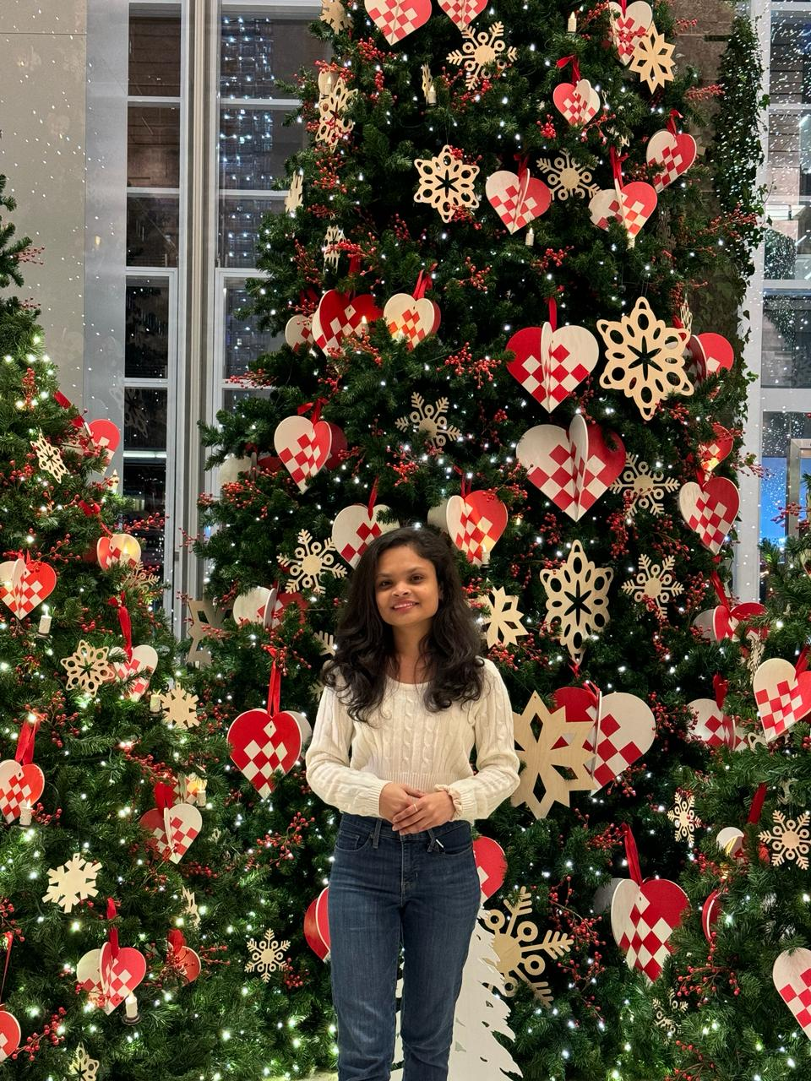
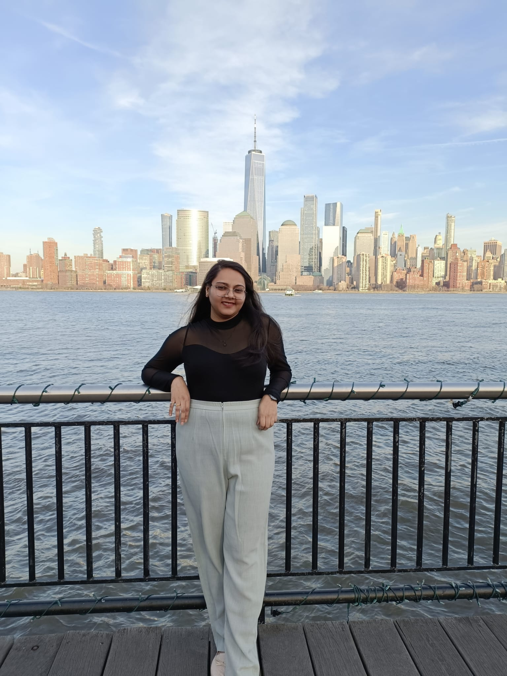
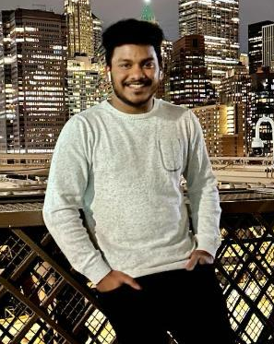
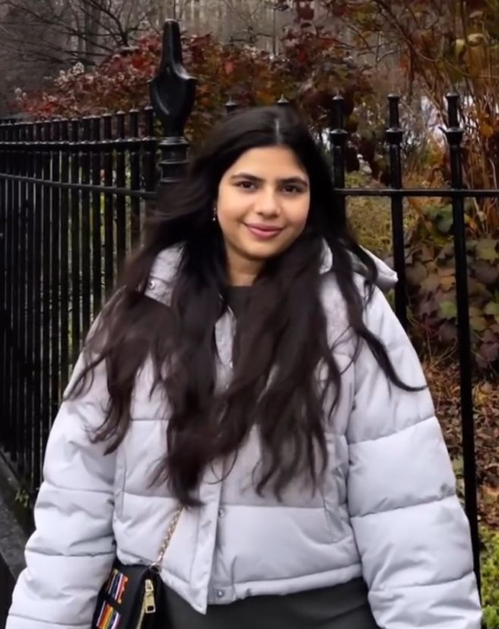
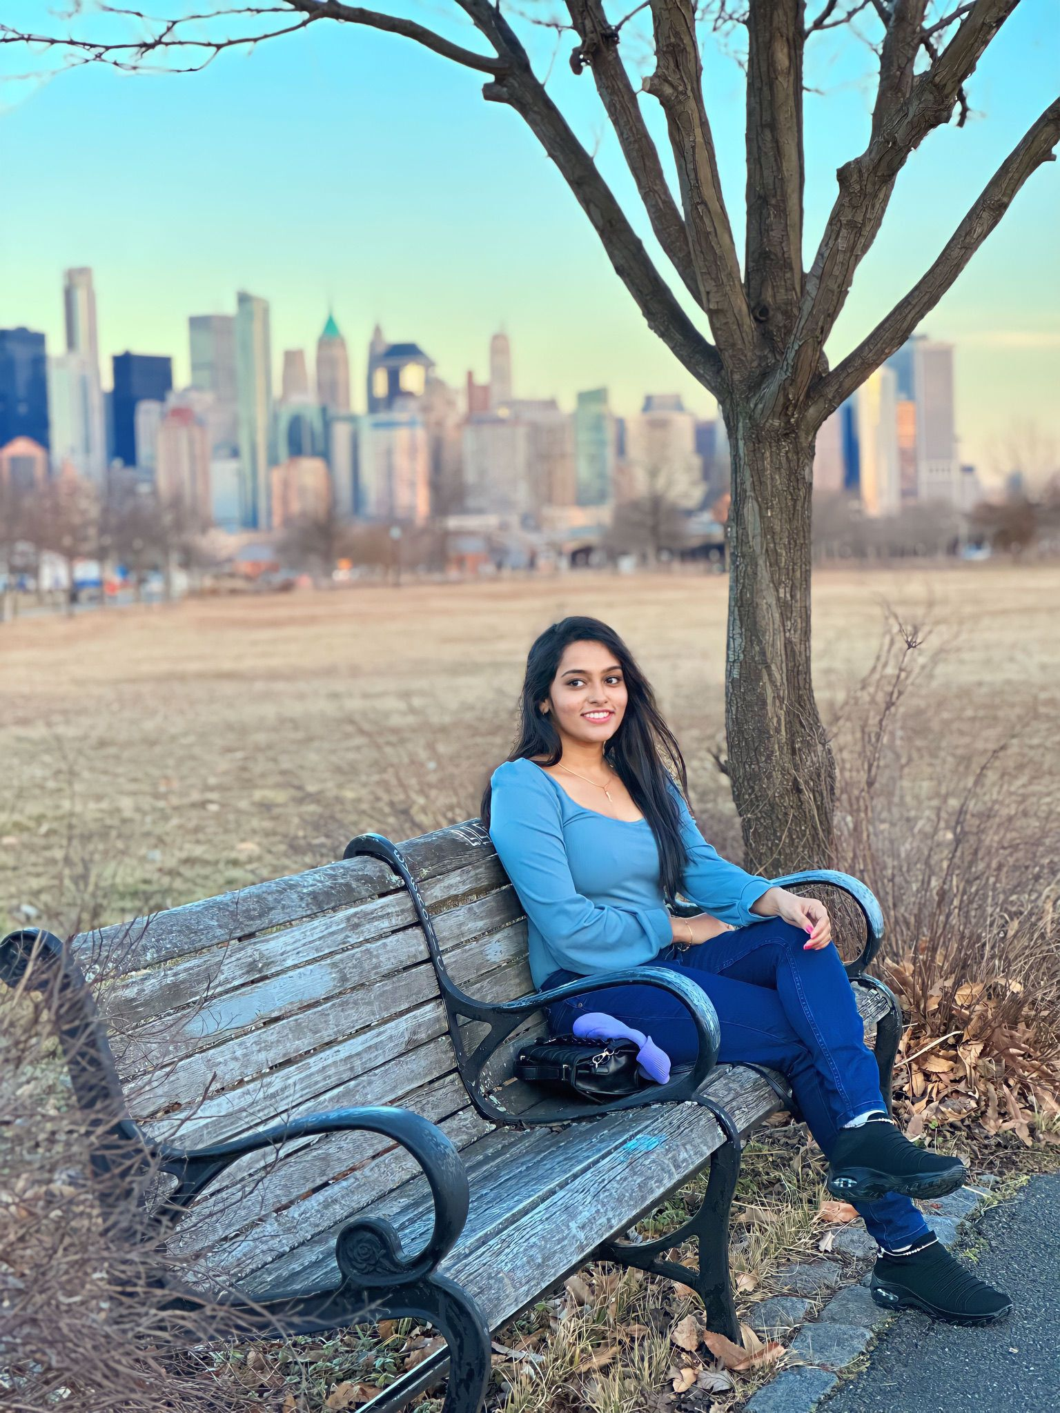
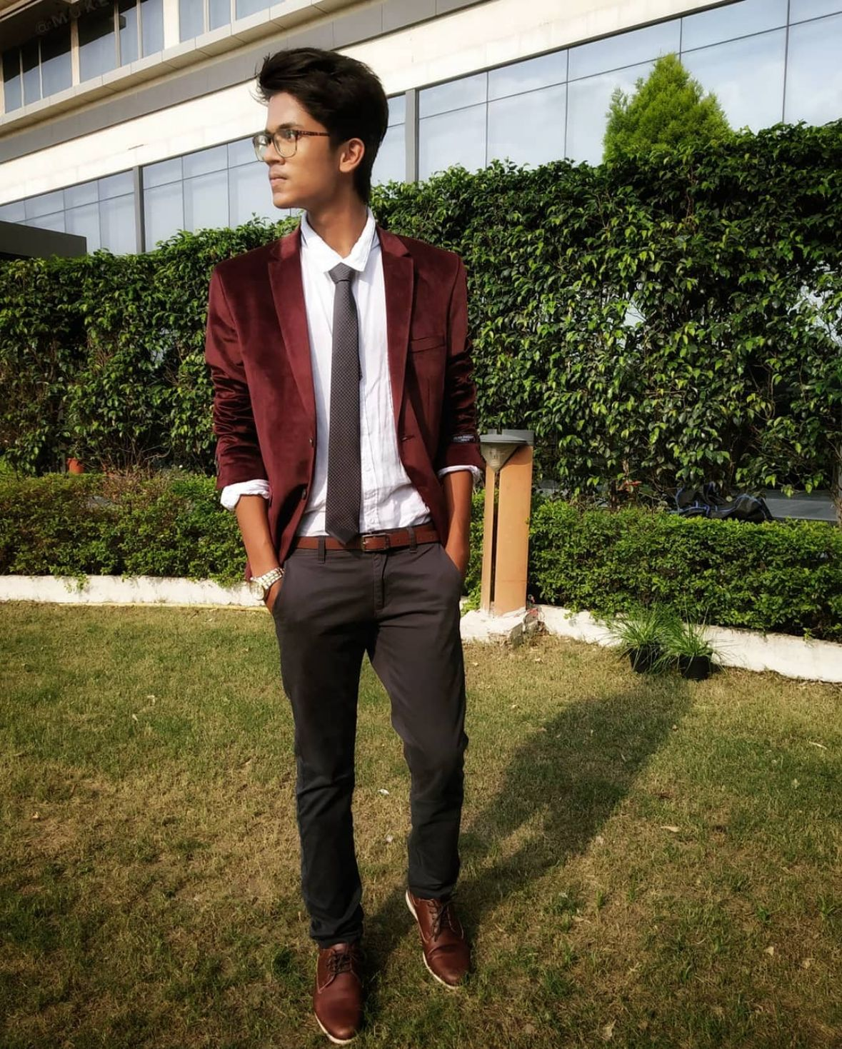
Our Team
Rudra Chobe
Omkar Gurav
Shriya Haral
Ritika Chougala
Lokeshwar Anchuri
Niyati Ghagada
Uma Maheswari Addala
Mukesh Suddala

Slide 3
Table of Contents
01.
02.
03.
04.
05.
06.
Problem Statement
Project Description
Personas
Market Analysis
Project Timeline and Tools
Retrospective

Slide 4
Problem Statement
The agriculture sector plays a crucial role in sustaining global food security, and plant diseases pose a significant threat to crop yield and quality. Identifying and managing these diseases in a timely and accurate manner is essential for ensuring food production. However, the current methods of plant disease detection often rely on visual inspection by experts, leading to delays in diagnosis and sometimes inaccurate assessments. Additionally, the increasing complexity and variability of plant diseases make it challenging for traditional methods to keep pace with emerging threats. There is a pressing need for advanced and automated plant disease detection systems that can provide rapid, reliable, and precise identification of diseases, enabling farmers to take proactive measures to protect their crops and enhance overall agricultural productivity.

Slide 5
Problem Statement
Furthermore, the economic impact of plant diseases on farmers and the agriculture industry is substantial, with losses stemming from reduced yields, increased use of pesticides, and the potential spread of diseases to neighboring crops. In the face of climate change and global trade, the dynamics of plant diseases are evolving, necessitating a more adaptive and technology-driven approach to diagnosis and management. The development of efficient and scalable plant disease detection solutions that leverage advancements in artificial intelligence, machine learning, and image processing is paramount. By addressing these challenges, we can empower farmers with timely information, minimize crop losses, promote sustainable farming practices, and contribute to the overall resilience of the agricultural sector in the face of emerging plant health threats

Slide 6
Project Description
"Eco Scan" is a pioneering project leveraging Convolutional Neural Networks (CNN) and image processing techniques for rapid and accurate plant disease detection. Using high-resolution images of plants, the system employs advanced CNN algorithms to analyze and identify potential diseases swiftly. The project's primary objective is to provide a user-friendly interface for farmers, allowing them to upload crop images and receive real-time analyses, enabling early disease detection and informed decision-making. By integrating state-of-the-art technology into agriculture, Eco Scan aims to optimize crop health monitoring, minimize losses, and promote sustainable farming practices.

Slide 7
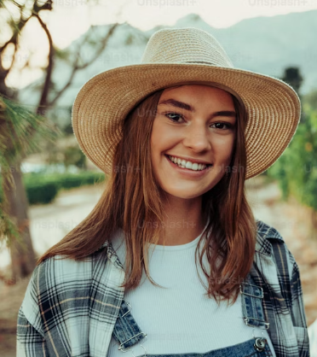
PERSONAS
Ava, the progressive farmer is deep-rooted in the rhythm of the seasons, guiding her farm through cycles of growth and harvest. Yet, she's no stranger to the harsh realities of plant disease and its impact on yield and sustainability. Faced with the complexities of organic farming, she's seeking innovative solutions to protect her crops without resorting to chemical interventions.
Interests
Aside from her passion for sustainable farming, Ava is interested in the latest agricultural technologies that can help optimize organic farming practices.
Frustration
The unpredictability of plant diseases and the limited effectiveness of conventional organic methods in rapid detection and management are her main obstacles.
Goals
Ava is determined to integrate cutting-edge technology into her farming practices to boost productivity while adhering to organic principles.
Name: Ava
Age: 28
Location: Ames, Iowa
Occupation: Owner and
operator of an organic farm
Income: $66,000/annually
Family: Married

Slide 8
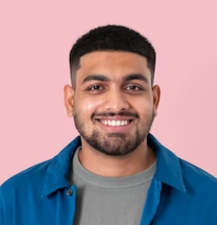
PERSONAS
Raj is a visionary in his field, constantly coding and testing the limits of artificial intelligence to serve the earth's farmers. He sees the potential in every line of code to revolutionize traditional farming practices. However, he struggles to find real-world test beds for his algorithms, which are necessary to refine and tailor his solutions to the nuanced needs of agriculture.
Interests
Participating in Hackathons, Coding contests etc.
Practicing yoga and mindfulness
Emerging tech in AI.
Frustration
Access to diverse agricultural data and the hesitancy of the farming community to adopt new technologies are his primary challenges.
Goals
To develop a robust platform that can adapt to various agricultural contexts and improve farm resilience against diseases.
Name: Raj
Age: 30
Location: New York City, NY
Occupation: AI Software
Engineer in Agri-Tech
Income: $120,000/annually
Family: Single

Slide 9
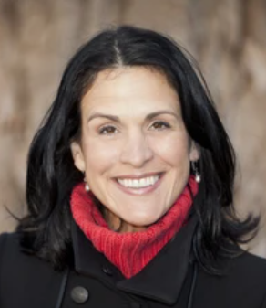
PERSONAS
Claire is a bridge between the agrarian world and the halls of legislation, tirelessly working to shape policies that promote ecological stewardship and technological innovation in farming. She understands the urgency of sustainable agriculture in the face of climate change but is often met with resistance from policymakers reluctant to prioritize or fund these initiatives.
Interests
Enjoys reading about global economic trends.
Organizes educational workshops on sustainability.
Enjoying weekend family outings
Frustration
Her challenge is to navigate the complex political and economic landscapes to secure support and funding for agricultural technology initiatives
Goals
To influence the adoption of sustainable agriculture policies that support and encourage the use of advanced technologies like "Eco Scan."
Name: Claire
Age: 52
Location: Brussels, Belgium
Occupation: Environment Policy Advisor
Income: $70,000/annually
Family: Married

Slide 10
TEAM AGREEMENT
Participation and Work Division
All the team members are expected to attend the meeting promptly and involve in discussions. Absence of team member will affect teams’ performance and efficiency.
If team member is not able to attend the meeting, he/she should let the team know earlier.
The entire project should be divided into equal parts and equal responsibilities should be given to all team members.
Each team member should complete their respective work before the deadline. If they are unable to complete the work on time, that hinders the performance of entire team. If in case any team member is facing issue at any point, they can share it with other team members so they can help each other and get the work completed before deadline.
Communication
The team will communicate through WhatsApp Group and for weekly meetings Teams will be used.
Jira software will be used to track the assigned tasks.
Task management, bugs, sprint planning and meetings minutes will be tracked in Jira.
Google docs will be used to share the final deliverable where all team members will be able to edit the document.
Meetings
All team members will meet virtually on Teams everyday. All the team members must be present, as attendance is mandatory unless there is an emergency.
A meeting track or meeting minutes reports would be listed after every meeting to keep track of the project and its progress.
Every team member is expected to come up with ideas.

Slide 11
Business analysis (Things to consider)
Who are the potential stakeholders?
Farmers , agricultural researchers, Technology providers.
What are the existing solutions?
Traditional methods: individual inspections from time to time, lab testing
AL-ML methods: SVM, CV, CNN, Random Forest and many more.
Does it provide cost-to-benefit ratio?
Considering the hardware and software cost to be affordable as right now the hardware and software available is costly.
Solution: Early-stage disease detection as this can help to reduce the manufacturing cost.
How is the user experience right now for the existing products?
Difficult for farmers to understand the interface.
Has bugs which leads to wrong detection of the diseases.
Less accuracy for the providing the solutions for that disease.
Time consuming: Takes a lot of time for loading and processing the data.
Paid subscriptions
Which are existing AI apps and websites?
Blossom AI : Paid subscriptions
PlantSnap : Free trail for 7 days
Plantix: Free
Agriapp: Paid subscription

Slide 12

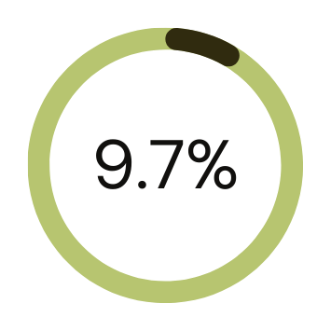
MARKET ANALYSIS
Market Potential: The global agricultural technology market is growing rapidly, with a specific demand for solutions addressing crop diseases. The plant disease detection market is expected to witness substantial growth due to increasing awareness of the impact of diseases on crop yields.
Competitive Landscape: Limited competitors with similar offerings, providing an opportunity for differentiation and market capture.
Regulatory Environment: Compliance with agricultural and environmental regulations will be crucial. Collaboration with agricultural research institutions and government bodies is essential for validation and regulatory approvals.
THE GLOBAL PATHOGEN OR PLANT DISEASE DETECTION AND MONITORING INDUSTRY WAS VALUED AT $1.76 BILLION IN 2022
$1.76 B
EXPECTED TO GROW WITH A CAGR OF 9.68% DURING THE FORECAST PERIOD 2023-2028 TO REACH $3.03 BILLION BY 2028.

Slide 13
What are existing AI-ML Models?
Approach | Method used? | What are the features? | Accuracy | Drawbacks
Image- based Plant Disease detection [1] | CNN | 38 Classes containing crop species and disease Dataset: PlantVillage | 99.35 | Classifying the single leaves
Using Computer Vision and ML Algorithms [2] | DWT+PCA+GLCM+CNN DWT: Discrete Wavelet Transform | 6 classes Tomato plant diseases Dataset: Village(Tomato plant) | 99.09 | Can be used for one plant sample
Using Machine Learning [3] | Logistic Regression, SVM, K-Nearest Neighbour, Random Forest , Naïve Bayes | 160 images of Papaya Leaves using Histogram of an Oriented Gradient (HOG) in MATLAB | Logistic Regression = 65.33, SVM= 40.33, K-Nearest Neighbour= 66.76, Random Forest = 70.14, Naïve Bayes= 57.61 | Less accuracy
Rice plant disease detection using ML [4] | LR, KNN, DT and Naïve Bayes | 3 classes :Bacterial plant blight, Brown spot, and plant smut, each having 40 images | LR= 70.83 KNN= 91.66 DT= 97.91 Naïve Bayes = 50 | Only for Rice plant
Using ML , raspberry and sensors [5] | Lenet-5 | 6 classes Dataset: Plant Village | 99 | Less no of Features .

Slide 14
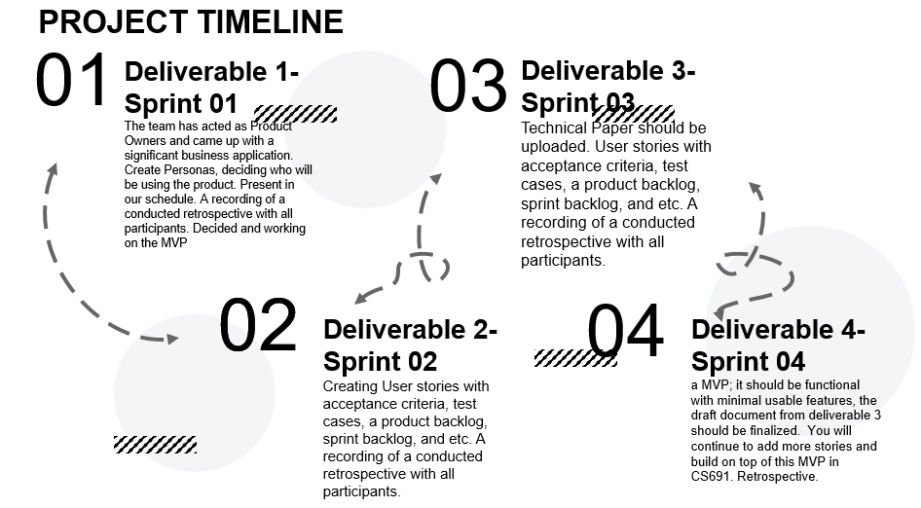
PROJECT SCHEDULE

Slide 15










TOOLS AND LANGUAGES

Slide 16

RETROSPECTIVE

Slide 17

What helped us move forward
Good communication helped us understand the goal clearly.
Working together was useful for collecting the necessary information.
We've noted the technologies we'll use, but we still need to learn more about them to create a great product.

Slide 18
What held us back
Coordinating meetings was tough due to everyone's different schedules.
Team participation suffered because of workload and communication challenges.
Uneven workloads made it hard for some team members to contribute fully.

Slide 19
What should we do next
Work together and make sure everyone in the team understands the goals and expectations of the project by communicating effectively.
Create a timeline that everyone in the team can see, with clear dates for important milestones and deadlines that each person needs to meet.
Start contributing to the project as soon as possible, creating a proactive and productive atmosphere that helps us finish the project successfully.

Slide 20
Wiki Page Link
https://github.com/htmw/2024S-AlgoAvengers

Slide 21

THANK YOU

